Slide 1
PRIZES – Video instructions
METASTARS REWARDS RESILIENT EUROPEAN SMEs!

Slide 2
METASTARS Prizes Open Call
To apply to METASTARS Prizes:
1) Complete the administrative form and send it to info@metastars-euroclusters.com with the written transcription of your video.
2) Make a short video between 3 and 5 minutes in English following instructions on the next slides and upload it here
Application deadline:
23 August at 23:59 CET

Slide 3
Video instructions (1/3)
Video applications should respect the following format:
Max duration: 5 minutes
Video in English
Video file in MP4
Horizontal format
The video should start with an opening slide using the template on slide 6
To ensure the accessibility of videos to all public voters, a text transcription of the video in a Word document should be sent along with the administrative form to info@metastars-euroclusters.com

Slide 4
Video instructions (2/3)
The video should address the following topics:
SME presentation (name, country, size, sector of activity and core business…)
Challenges faced by the SME (green and digital transition, internationalisation and access to new markets, upskilling and reskilling of the workforce, cybersecurity, disruption of the supply chain,…),
Actions already implemented or planned by the SME to be more resilient and respond to these challenges (strategy, action plan, change of internal processes, new products or services…).
Suggested duration:
30s-1m
1-2m
1-2m
Application videos sent to the METASTARS consortium will be published on the METASTARS webpage. No confidential information should be mentioned.

Slide 5
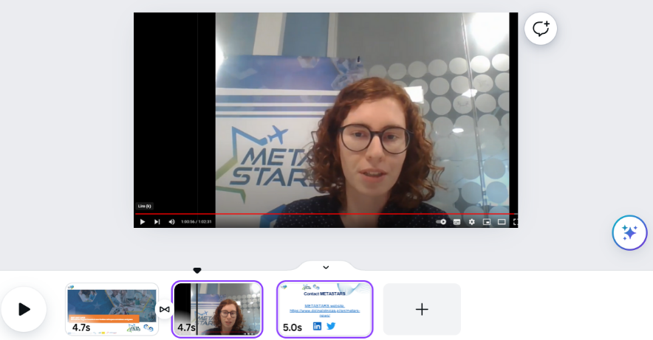
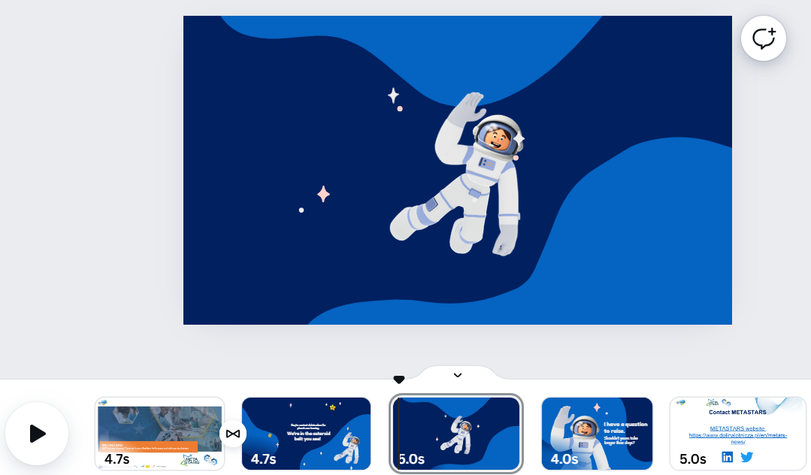
Video instructions (3/3)
Public voters will contribute to applications’ evaluation so the dynamism of the video is important: avoid a simple succession of slides and prefer personalized presentations or video animations.

Slide 6
METASTARS - Call for Prizes
SME NAME Application
SME LOGO

Slide 7
Contact
For any question regarding the prizes,
please write to info@metastars-euroclusters.com
Contact and news
METASTARS website https://www.dolinalotnicza.pl/en/metars-news/

Slide 8
METASTARS PRIZES
GOOD LUCK TO ALL AND LOOKING FORWARD TO RECEIVE YOUR APPLICATIONS!

